Slide 1
Session 11 – Physical & Environmental
MIS 6311-501 Cyber Security Fundamentals
Chris Davis

Slide 2
Housekeeping
Any Questions? Please do not hesitate to email. Or text.
Class Website: https://elearning.utdallas.edu
Dropbox: https://goo.gl/9AFyoE
UTD Email: cmd140430@utdallas.edu
Gmail: davischr2@gmail.com
Google Voice: 214-771-8122 (Text & Emergencies)
LinkedIn: www.LinkedIn.com/in/ChristopherDavis
Blog: www.cloudauditcontrols.com
Class: Monday 7:00pm-9:45pm JSOM 12.210

Slide 3
Academic Calendar & Sessions

Slide 4
Comparison of Our Class to CISSP Domains
Shon Harris Book – Chapters
Current CISSP Domains
2
Information Security Governance and Risk Management
8
Business Continuity and Disaster Recovery Planning
Security and Risk Management
9
Legal, Regulations, Investigations and Compliance
7
Cryptography
Security Engineering
4
Security Architecture and Design
Security Assessment and Testing
5
Physical (Environmental) Security
Asset Security
6
Telecommunications and Network Security
Communications and Network Security
3
Access Control
Identity and Access Management
11
Operations Security
Security Operations
10
Software Development Security
Software Development Security

Slide 5
Tales from the Crypt.
Practical Applications & Lessons Learned.

Slide 6
UPDATES!
Projects
Photos

Slide 7
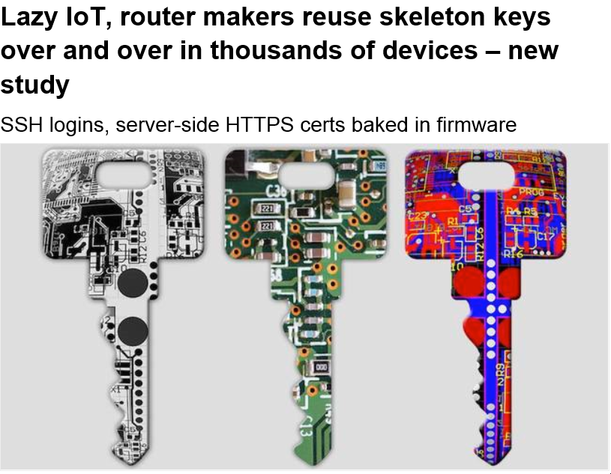
It's what we all assumed, but quietly hoped wasn't quite this bad.
Lazy makers of home routers and the Internet of Things are reusing the same small set of hardcoded security keys, leaving them open to hijacking en masse, researchers have warned.
In other words, if you can log into one gizmo remotely, you can probably log into thousands upon thousands of others – even devices from a different manufacturer.
Infosec biz Sec Consult says it studied 4,000 embedded devices from 70 hardware makers, and found that many products are sharing the same hardwired SSH login keys and server-side SSL certificates.

Slide 8
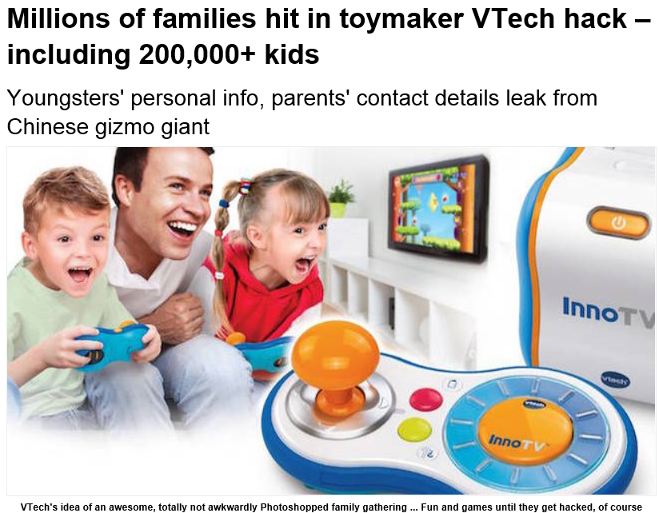
Names, home and email addresses, security questions and answers, and more information on millions of families worldwide have been swiped from a top toymaker's database.
And the birthdays, names, and genders of nearly a quarter of a million kiddies have been accessed, too.
Chinese electronics giant VTech today admitted its systems were compromised on November 14. Miscreants were able to extract customer records from its Learning Lodge app store, which provides downloads of games, books, music and other stuff for VTech toys. The Hong Kong-based biz specializes in making computer-like gizmos for preschool kids to play with, settling them in for a lifetime of fondleslab smearing and internet addiction.
Computer security bloke Troy Hunt says he has seen a copy of the swiped information, and reckons he found "4.8 million unique customer email addresses," suggesting that many accounts have been raided by hackers.

Slide 9
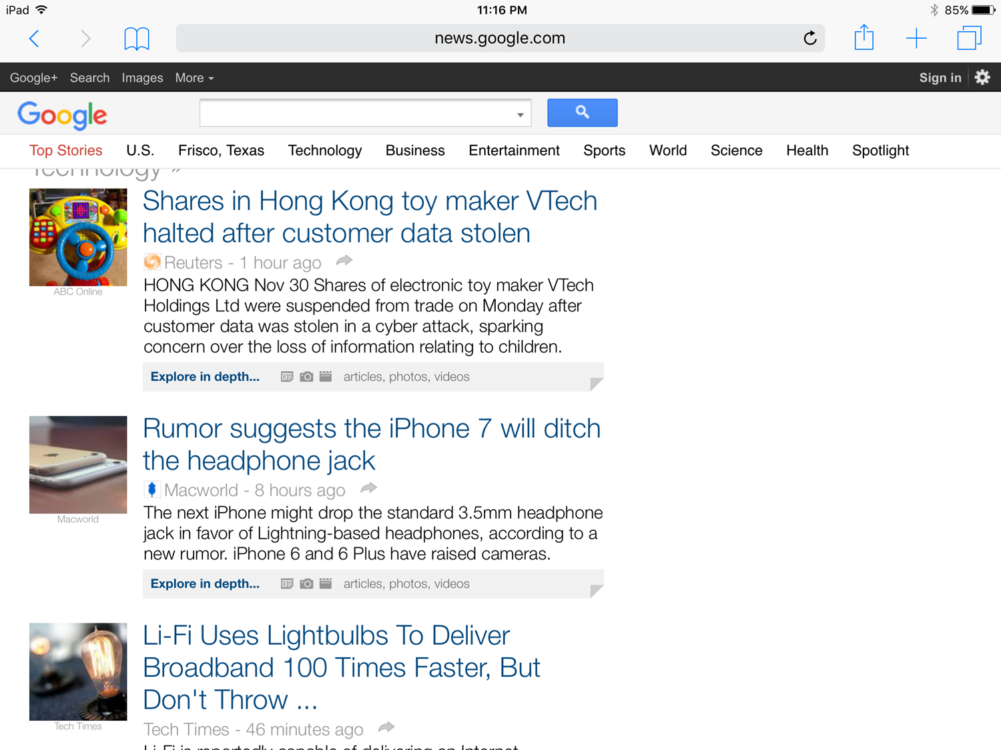

Slide 10
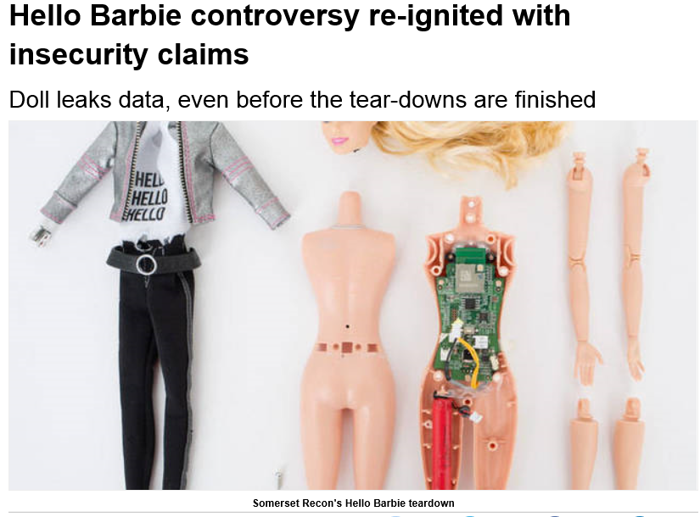

Back in February, The Register queried the security and privacy implications of Mattel's “Hello Barbie”, and now the doll has hit the shelves, a prominent security researcher has turned up the first security problems with the toy.
After an initial flurry of concern, the issue went quiet, but last Friday Matt Jakubowski (formerly of Trustwave's SpiderLabs) reignited it by extracting Wi-Fi network names, account IDs, and MP3 files from the toy.
That brought a defensive response from Oren Jacob, CEO of ToyTalk (which provides the cloud processing chunk of Hello Barbie). He called Jakubowski an “enthusiastic researcher”, said the data is “already available” to customers, and “no major security or privacy protections have been compromised”.

Slide 11
Let’s Get Started.

Slide 12
PHYSICAL SECURITY
Why do you care?
Types of Controls…

Slide 13
Information Security Controls
Technical | Access Control Systems, Two-Factor Authentication, Firewalls, Encryption Systems, Uninterruptible Power Supplies, Intrusion Detection Systems, Anti-Virus Software, Redundant Systems or System Components, Back-up Systems, Audit and Logging Systems, System Hardening
Physical | Security Guard, Key-Card Physical Access Systems, Alarm Systems, Safes, Fire Suppression Systems, HVAC Systems, Fences, Lighting, Security Cameras
Administrative or ‘Process’ | Acceptable Use Policy, Business Continuity Plan, Password Policy, Incident Response Plan, System Baseline Configurations, Remote Access Policy, File Recovery Procedures, Information Classification, Information Security Training and Awareness, Audits and Assessments

Slide 14
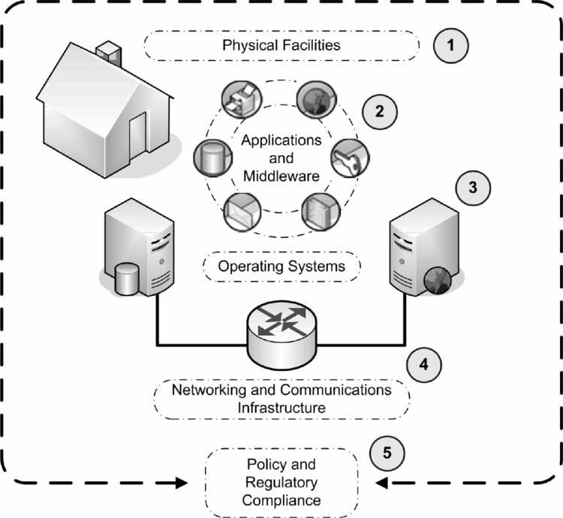
☑
☑
☑
☑
☑

Slide 15
Why Do We Care?
About: Information Security Management
About: Information Risk Management

Slide 16
Answer: Corporate Liability

Slide 17
Corporate Must Haves
1997 Federal Sentencing Guidelines Prudent Man Rule: “requires officers to perform duties with diligence and care that ordinary, prudent people would exercise under similar circumstances”
Exercising “Due Care” or “Reasonable Care” includes:
Institute measures to prevent own systems from being used to attack other entities
Implement backups
Scan for malicious code
Business continuity / Disaster recovery plans
Local and remote access controls
Eliminate unauthorized and open modems
Have security policies, procedures and guidelines
Use personnel screening procedures
Establish an incident handling capability
Legal liability exists if the cost to implement solution is less than the cost of a successful attack on the data

Slide 18
Environmental Exposures and Controls Primer
Notes:
18

Slide 19
Physical Security

Slide 20
Physical Security Threats
Physical: Nature, Vandals (people), Terrorism, Projectiles, Fire
Environmental: Temperature, Gases, Humidity, Weather, Organisms (including black mold), Static Electricity, Earth Movement
Utility: Power, (spikes, surges, brownouts) Water, Sewer, Telecommunications

Slide 21
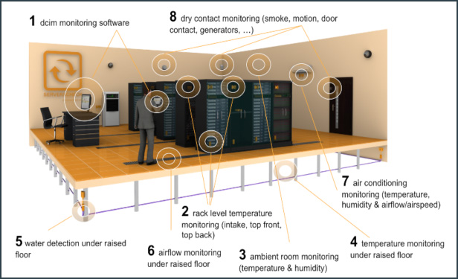

Slide 22
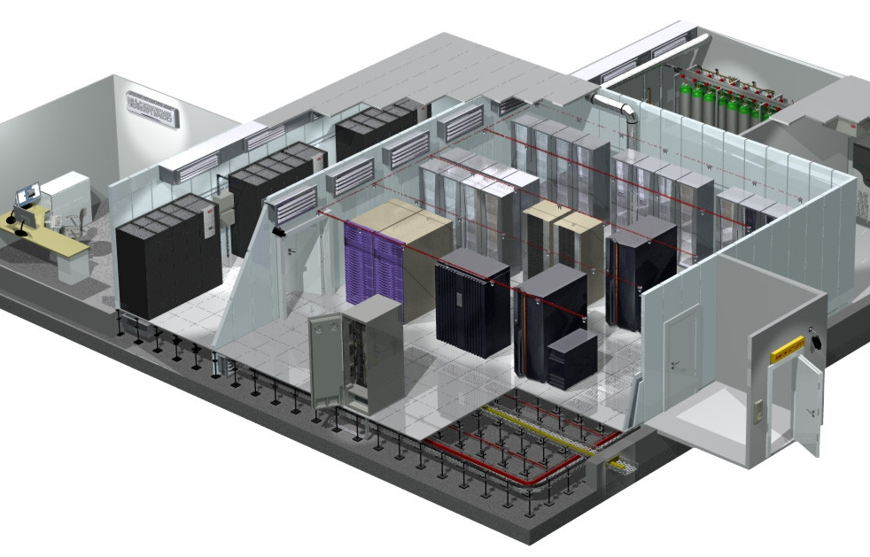
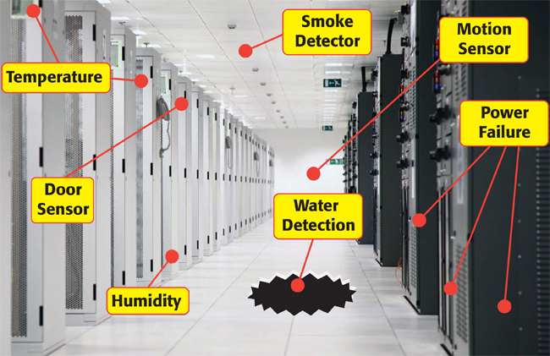
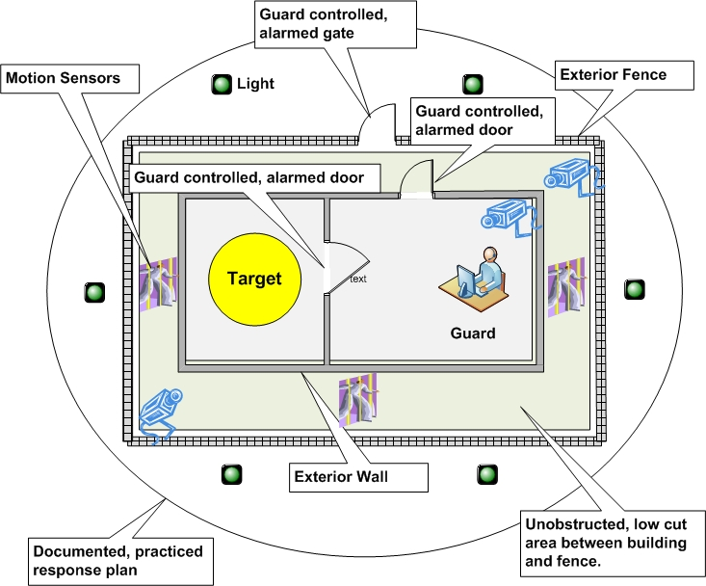
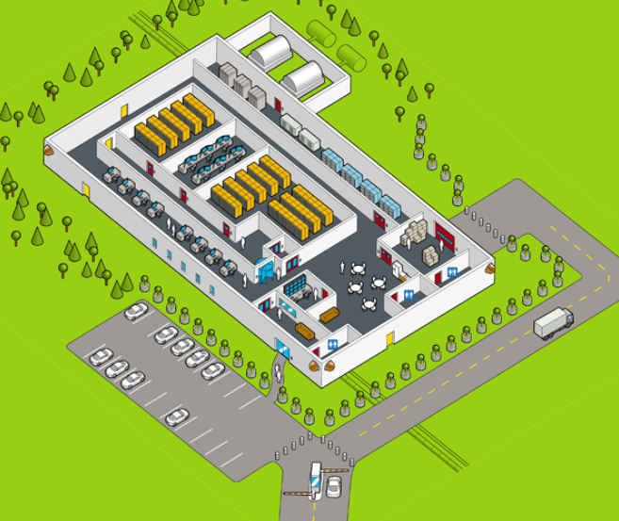

Slide 23
Reflective Questions
What Environmental Threats Should We Be Concerned About in North Texas?
Name Three Physical Threats that Your Organization Faces?

Slide 24
Facility and Personnel Controls

Slide 25
Administrative Controls
Facility Requirements Planning
Facility Security Management
Personnel Controls

Slide 26

Choosing a Secure Site
Neighborhood
Joint Tenancy
Natural Disasters
Visibility (low key is the rule here)
Public Access, Roads, Congestion
Proximity to Emergency Services

Slide 27
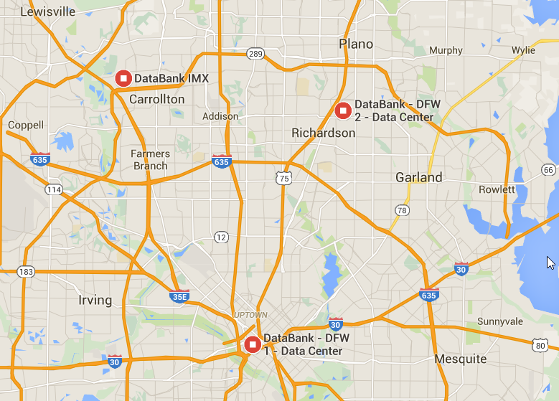
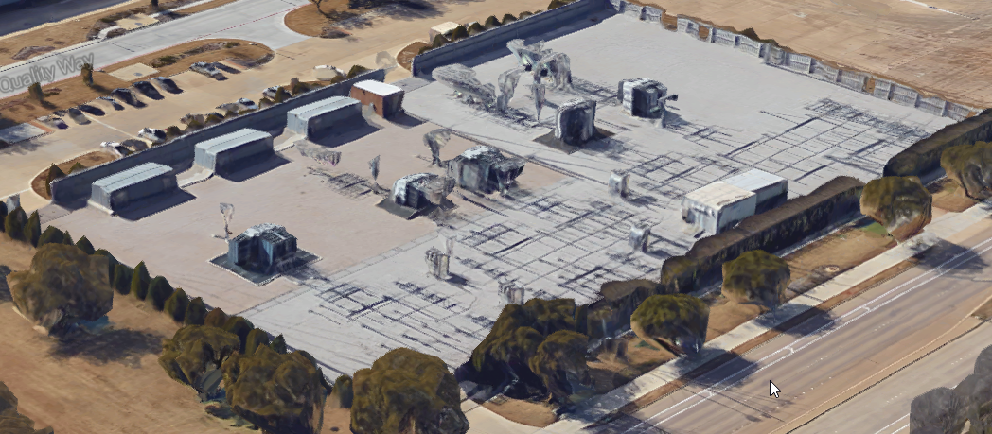
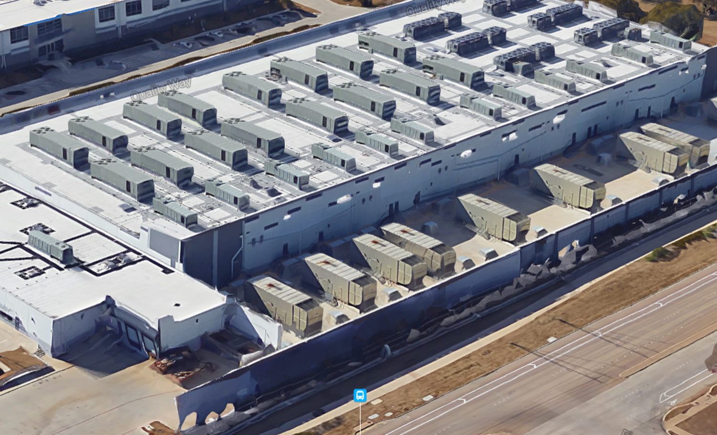
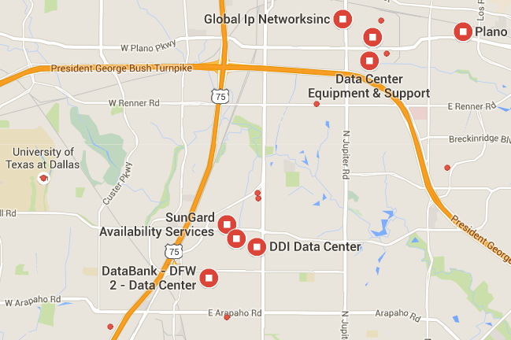
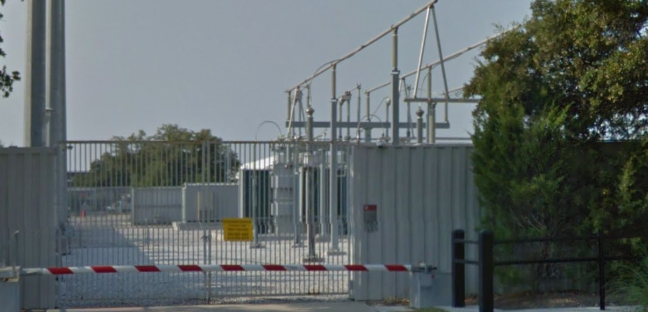
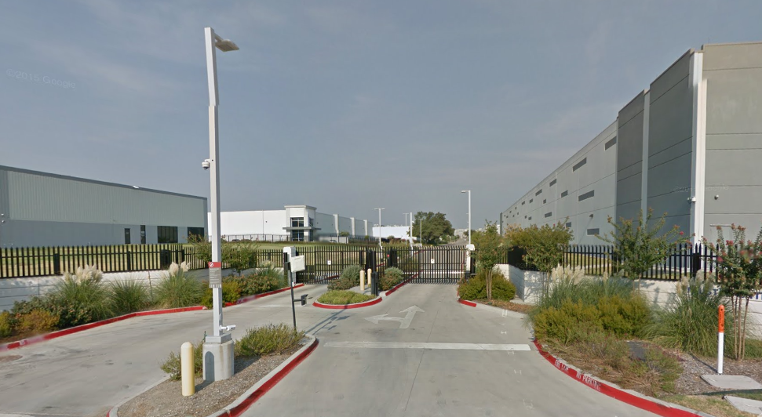
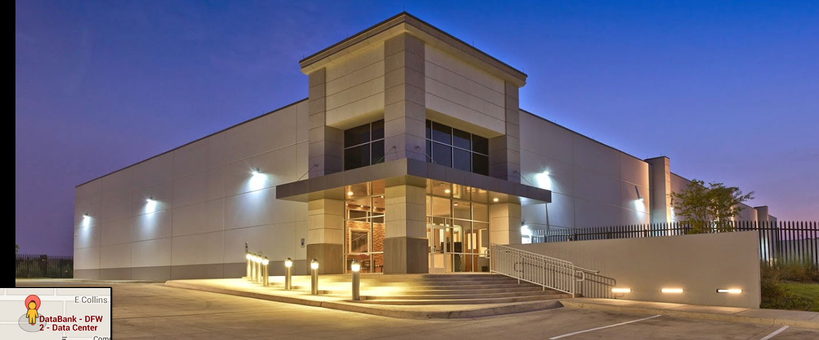

Slide 28
Designing a Secure Site
Exterior Protection (i.e. fences, bright lighting)
CCTV, Guards, Alarm Systems
Limited Window Space or Shatter-proof Glass to Prevent Break-in
Physical Barriers to Block Unauthorized Drive-in/Break-in
Interior Spaces Divided (separated) for Different Purposes
Collocation Physically Separated by Function in the Data Center

Slide 29
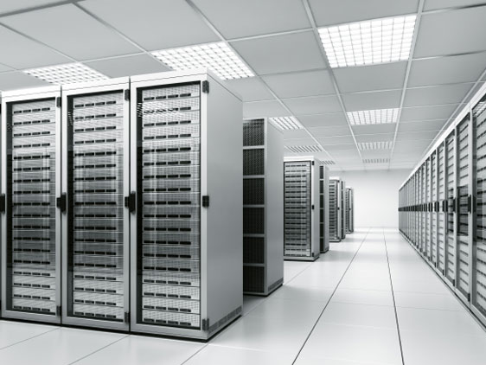
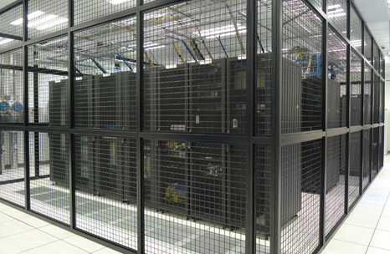
Building Construction
Ceilings – Weight Bearing and Fire Rating
Doors, Walls – Fire Resistance for 1 ½ to 2 Hours
Floors
Slab – “Loading” of 150 Pounds Per Square Foot, Fire Resistance
Raised – Designed to Spread Load Over a Large Area
Windows – Should Be Translucent and Shatterproof

Slide 30
Building Construction (Cont.)
Doors
Must resist Forcible Entry
Fire Rating Equal to or Greater Than Walls
Emergency Exits Should Be Clearly Marked
Electronic Locks Should Fail Open With No Re-Entry During Power Outages

Slide 31
Building Mechanicals
Sprinkler System – Location and Type of system
Water or Gas Lines – Location and Potential Hazards Near Lines
Drains – Should Be Positive (flow out only)
Heating Ventilation and Air Conditioning
Adequate Capacity
Water Drains Should Be Positive
Protected Air Intakes and Positive Air Pressure
Electrical Power
Backup and Alternate Power Sources
Dedicated Feeders

Slide 32
Facility Security Management
Access Control System Logging
Identification of Person Attempting Access
Date and Time of Access Attempt
Success/Failure
Location of Entry
System Modifications (privileged access)
Emergency Procedures
System Shutdown Procedures
Evacuation Procedures
Employee Awareness
Periodic Safety Equipment and System Tests

Slide 33
Personnel Controls
Pre-Employment Screening
Periodic Employee Checks
Post-Employment Procedures
Exit Interview
Remove of Network Access
Return of Company Owned Equipment

Slide 34
Environmental, Utility, and Fire Controls

Slide 35
Environmental Life and Safety
Electrical Power
Fire Detection and Suppression
Heating, Ventilation and Air Conditioning

Slide 36
Electrical Safety
What does it take to kill you?
.1 Amps across the heart will kill you
300 Ohms worst-case body resistance
Current (I) x Resistance (R) = Potential (V)
.1 Amps x 300 Ohms = 30 Volts
Bottom Line: Don’t mess with electricity.
How to save someone being shocked
DON’T TOUCH THEM WITH YOUR HANDS!!!
Unplug or Turn off the power if possible
Drop kick them (similar or larger size)
Momentum (child)
Can use your belt

Slide 37
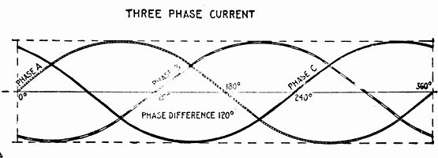
Electrical Power
Noise – Unintentional Electrical Radiation that Interferes With Power Transmission
Line Conditioning
Grounding
Cable Shielding
Avoid Routing Cable Near Magnets, Florescent Lights, Electrical Motors, etc.

Slide 38
Power Fluctuations
Blackout – Complete Power Loss
Brownout – Prolonged Low Voltage
Sag – Momentary Low Voltage
Surge – Prolonged High Voltage
Spike – Momentary High Voltage
Inrush – Initial Surge at Power On
Noise – Steady Power Disturbance
Transient – Short Duration Line Noise
Clean Power – Consistent Power Signal
Ground – One Wire Connected to Earth Ground

Slide 39
Humidity
Ideal Operating Humidity is Between 40% and 60%
Static Charges Can Reach 20,000 Volts
40 Volts Can Damage Circuits and Transistors
1,000 Volts Will Scramble a Computer Monitor
1,500 Volts Can Cause Magnetic Media Failure
2,000 Volts Can Cause System Shutdown
4,000 Volts Can Cause Printer Jams
17,000 Volts Can Cause Permanent Chip Damage

Slide 40
Humidity Related Safeguards
HVAC Systems Should Maintain Proper Level of Humidity
Electrical Circuits Should Be Grounded Properly
Anti-static Flooring, Mats, Tables and Sprays Should be Used

Slide 41
Water Related Safeguards
Water Barriers at External Doors
Water Sensors in Close Proximity to:
Exterior Doors
Drains (including HVAC)
Supply Pipes
Bathrooms (if close to computer systems)
Routing Water Pipes Away from Computer Systems
Automatic Shut-offs
Emergency Procedures

Slide 42
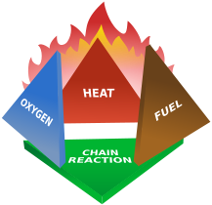
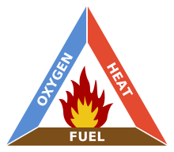
Fire Suppression Mediums
Water – Reduces Temperature
Soda Acid – Suppresses Oxygen
CO2 – Suppresses Oxygen
Halon – Chemically Suppresses Combustion
The old Fire Triangle…
and the NEW!!!
Fire Tetrahedron!

Slide 43
Major Fire Classes and Suppression
Class | Description | Suppression Mediums
A | Paper, Wood and Other Common Combustibles | Water or Soda Acid
B | Gasoline and Other Liquid Flammables | CO2, Soda Acid, AFFF
C | Electrical | CO2
Note that there are differences across International codes as to how fires are classified. Additionally, this table is *not* conclusive. These are the most commonly identified and discussed classes.
Questions to make you think:
-- Water and Oil? No!
-- Water and Electricity? Ever? 30º Water Fog – Trained FF Only

Slide 44
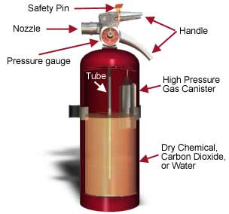
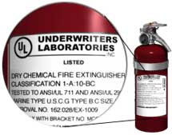

Fire Extinguishers
Source: http://www.osha.gov/SLTC/etools/evacuation/portable_about.html

Slide 45
Fire Detectors
Heat Sensing
Flame-Actuated
Smoke-Actuated

Slide 46
Fire Extinguishing Systems
Gas-based
CO2
Halon
Halon 1211 – Is a Liquid
Halon 1301 – Is a Gas
Halon Replacements
Water-based
Wet Pipe – System is Always Filled
Dry Pipe – Water Fills the Pipe During Discharge
Deluge – Dry Pipe With A Large Quantity of Water
Pre-action – Water Fills the Pipe Prior to Discharge

Slide 47
Halon Questions
What is Halon? Halon (short for halogenated hydrocarbon) is a liquefied gas that is used to extinguish fire by chemically interrupting the combustion chain reaction. It is nonconducting and described as a "clean agent," as it leaves no residue after being discharged. Halon fire extinguishing agents include Halon 1211, Halon 1301, and a combination of the two (Halon 1211/1301). The four-digit number represents, respectively, the number of carbon, fluorine, chlorine, and bromine atoms present in one molecule. Both Halon 1211 and 1301 have Class A, B, and C ratings and have relatively low toxicity and electrical conductivity. Halon 1211 is a "streaming agent," and more commonly used in hand-held extinguishers because it discharges mostly as a liquid stream. Halon 1301 is a "flooding agent," and discharges mostly as a gas, allowing it to penetrate tight spaces and behind obstacles and baffles.
The Trouble with Halon Halons have been found to be an ozone-depleting substance, harmful to the Earth's stratospheric ozone layer, and have an unacceptable "global warming potential." As of January 1, 1994, under the Clean Air Act, the United States has banned the production and import of Halons 1211 and 1301 in compliance with the Montreal Protocol On Substances That Deplete The Ozone Layer. This ban does not eliminate the use of halons as fire suppressants. It does, however, significantly affect the cost and availability.
Source: http://www.fs.fed.us/eng/pubs/html/96571301/96571301.html

Slide 48
Halon Replacements
FM-200
CEA-410 or CEA-308
NAF-S-III
FE-13
Argon
Inergen
Low-pressure Water Mists

Slide 49
Fire Contamination
Smoke
Heat
Water
Suppression Medium Contamination (soda acid)

Slide 50
Heating Ventilation and Air Conditioning
Prevents temperature issues (overheating, freezing)
Controls static electricity by controlling humidity to about 40%-60%
Electronics suffer serious damage at 175 degrees
Magnetic media damaged at only 100 degrees

Slide 51
Facility Controls
Physical Security

Slide 52
Facility Control Requirements
Security Guards
Extremely Effective
Costly
Can Respond to Incidents with Cognitive Reasoning
Provides a Deterrent
Dogs
Acute Senses
Not as Useful as They Do Not Have the Reasoning Ability of A Guard
Potential Liability Issues

Slide 53
Fences and Lighting
Lighting should be at least 8 feet by 2 candle power (accepted industry measurement)
3-4 foot fence deters common trespassers
6 foot fence is too hard to climb easily, most people wont try
8 foot fence with 3 strands of barb wire deters most intruders

Slide 54
Locks and Cameras
Locks
Pre-set Locks – Typical Latch Type Locks
Programmable Locks – Mechanical Combination or Electronic Keypad Lock
Cameras (CCTV)
PhotoGraphic or Electronic
Can Be Used With a VCR

Slide 55
Facility Access Control
Access Cards
Photo-image Cards – Simple Photo ID
Digital-Coded Cards – Contain Chips or Magnetic Strips
Proximity Cards
Passive Devices – No Power
Field Powered Devices – Powered
Transponders – Reader and Card are Powered
Biometric Devices

Slide 56
Intrusion Alarms
Intrusion Detectors
Photoelectric Sensors – Uses Light Beams to Detect Movement
Dry Contact Switches – Magnetic Tape and Switches (least expensive)
Motion Sensors
Wave Pattern – Send an Alarm it the Pattern is Broken (used to secure entire rooms)
Capacitance – Monitor an Electrical Field Surrounding an Object (used to secure objects)
Audio Detectors – Detects Abnormal Sounds Such as Breaking Glass (high rate of false alarms)

Slide 57
Alarm Types
Local Alarm Systems – Audible Alarm (must be heard up to 400 feet)
Central Station Systems – Monitored 24/7 by a third-party
Proprietary Systems – Monitored 24/7 by the End User
Auxiliary Station Systems – Any of the Above Systems that are Connected to the Local Fire or Police Department

Slide 58
Alarm Related Terms
Line Supervision – Alarm Transmission Medium is Monitored for Tampering
Power Supplies – Backup Power to Supply at Least 24 Hours of Run-time

Slide 59
Computer and Media Controls
Physical Security

Slide 60
Physical Computer Controls
Cable Locks – Secure Computers to Immovable Objects Such as Desks
Port Controls – Devices that Secure Data Ports
Switch Controls – On/off Switch Cover
Peripheral Switch Controls – Lockable Switches that Prevent Keyboard Operation
Electronic Security Boards – Force Boot Password (usually a BIOS feature)

Slide 61
Media Storage Protection
Physical Access Control to Areas Where Media is Stored
Environmental Controls to Prevent Fire, Humidity or Water Damage
Removable Media Inventory Controls and Monitoring
Media Use Audits

Slide 62
Data Destruction and Reuse
Data Remanence – Residual Information Remaining on Media After Erasure (DoD – requires 7 passes)
Clearing – Overwriting Magnetic Media
Purging – Degaussing or Completely Overwriting Magnetic Media Before Resale
Destruction – Shredding or Physically Destroying Paper, Magnetic or Optical Media

Slide 63
Physical Security Walk-Through
Are Desks Clear of Sensitive Documents?
Are Workstations Logged Out When Not in Use?
Are Offices Locked When Not in Use?
Are Exits Propped Open?
Are Cabinets and Desks Locked?
Are Disks and CDs Secured?

Slide 64
Environmental Exposures and Controls Audit

Slide 65
Environmental Exposures
Water
Fire
Electrical
Air
Monitoring
Personnel
Reactor Scram

Slide 66
Water Exposures and Controls
Based on the data center’s location and the area surrounding the data center, determine the possibility of water damage. If there is a reasonable chance of water entering the data center, determine what controls are in place to prevent the water from entering the data center or detect the presence of water in the data center.
Are there water/steam pipes (other than water sprinklers) above the data center and/or is the data center located adjacent to or beneath a kitchen or restroom?
Are the air handlers water-cooled and/or could condensation from the air handlers go undetected.
Are there water detectors under the raised floor?
Are there water drains under the raised floor?
Is there protection from leaks in the roof and rooftop cooling systems?

Slide 67
Fire Exposures and Controls
Describe the type of fire / smoke detection, and extinguishing devices used to protect the data center from accidental or deliberate damage. For example,
Determine if the data center is separated from adjacent areas by fire-resistant partitions, walls, floors and doors.
Determine if anything is being stored in or near the data center of a combustible nature (i.e., paper stock, toners, cleaners or other chemicals).
Determine if an automatic fire extinguishing system protects the data center.
Determine if portable fire extinguishers are placed strategically throughout the data center or surrounding area, that they are tagged for inspection and inspected at least annually. Are they designed for electrical fires?
Determine if smoke detection devices are installed in the ceilings, raised floors, return air ducts, and other important zones. Determine how often are they tested.
Determine if hand-pull fire alarms are strategically located in or near the data center.
Consider talking with facilities personnel to understand city code requirements.

Slide 68
Electrical Exposures and Controls
Determine if there are redundant power sources feeding the data center so that the failure of a single power source does not adversely affect the electrical supply.
Determine if all computer equipment is attached to electrical surge protectors. (May be provided by UPS)
Determine if the various hardware devices are attached to an uninterruptible power supply (UPS) system.
How long will the UPS supply power to the room? Is all equipment (computers, air handlers, monitoring systems, badge readers, etc.) attached to a UPS?
Evaluate the use of dual power supplies to critical servers. The power supplies should receive their power from separate sources.
This could be from either a local auto-switching circuit unit in the equipment rack or from different power supply strips.

Slide 69
Air Exposures and Controls
Determine if an air conditioning (AC) system is being used exclusively for the data center and not being shared with other parts of the building.
Determine if the humidity and temperature readings of the data center are easily obtainable. What are the readings?
Optimal ambient temperature range is 70F – 74F
Optimal humidity is 45% - 50%

Slide 70
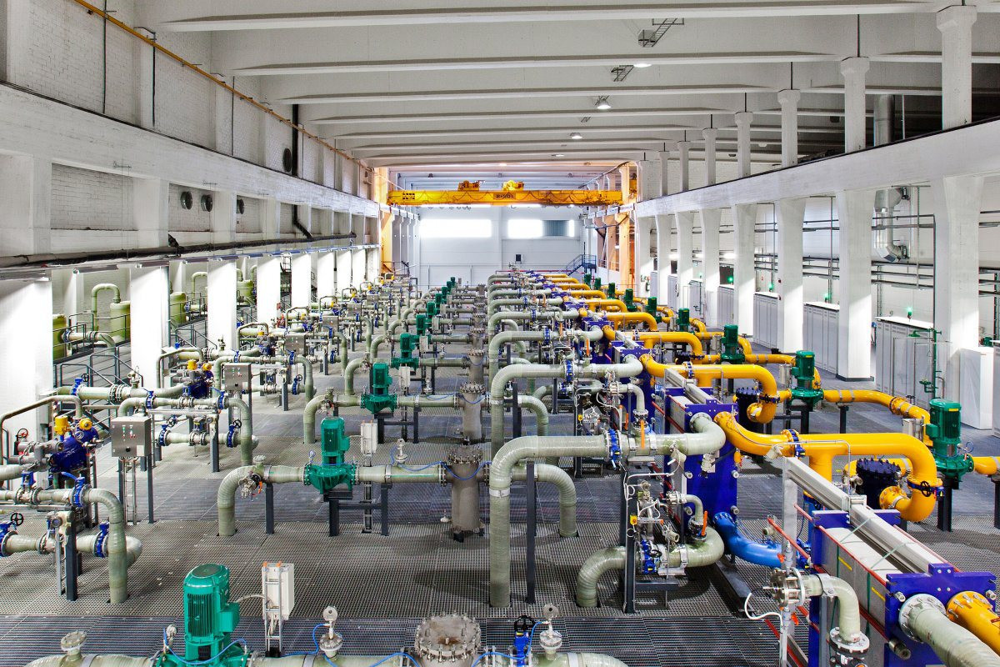

Slide 71
Monitoring Exposures and Controls
How are the environmental controls in the data center monitored?
Are the automatic water/fire/smoke detectors and fire suppression system linked to a central monitoring station?
Is the humidity and temperature of the data center being recorded? How often are these sensors looked at?
Is the UPS system being monitored for activation?
Determine how often the environmental controls are tested.

Slide 72
Personnel Exposures and Controls
Personnel health and safety
Determine if there are battery-powered emergency lights throughout the data center.
Are data center personnel trained in how to respond to an emergency (i.e. fire, electrical)?

Slide 73
Physical Access Exposures and Controls

Slide 74
Physical Access Exposures
Physical security measures are steps taken to manage physical access to an information resource.
Physical security is typically the first line of defense against theft, sabotage, and environmental disasters.

Slide 75
Physical Access Controls
When implementing access policies, consider any point of entry to your resources and assets.
Zoned entry to premises or equipment areas, e.g. with access cards
Doors, Walls, Ceilings, Raised Floors, Man traps
Bolted down equipment
Physical authentication devices such as guards, locks, biometrics, PIN codes, cameras, etc.
Locking, disabling, or disconnecting equipment
Visitor registration and badge creation processes
Entry and activity monitoring, e.g. CCTV and alarm system

Slide 76
Additional Key Terms

Slide 77
Final Thoughts

Slide 78
Final Thoughts

Slide 79
From Authorities to Audits
Examples
Technical, physical, and administrative requirements that must be in place to ensure compliance with the authorities
Statements of how a company will implement and enforce requirements
Implementation of the technical, physical, and administrative requirements found in the policy statements
Verification of appropriately implemented controls to comply with requirements
PCI
HIPAA
NERC
Authorities
Requirements
Policies
Controls
Audits
PCI-DSS Example
Authority: PCI-DSS is the authority document created by the PCI-SSC.
Requirement: (10.6) Review logs for all system components at least daily.
Policy: Monitoring Policy – States logs will be reviewed at least daily.
Control: Tool XYZ provides real-time monitoring for all system components.
Audit: Auditor verifies Tool XYZ is appropriately monitoring and alerting to actionable events. Audit results and evidence are stored as part of the audit.

Slide 80
Effectively Managed IT Controls
Technology can affect every part of the business.
At its best, technology is a competitive advantage.
At its worst, technology is your competitor’s advantage.
Product
Market Relationships
IT Controls:
Detective, protective and reactive measures in place to protect the confidentiality, integrity, and availability of business information and ensure appropriate management of the IT function to meet business objectives.
Inbound Logistics
Operations
Outbound Logistics
Marketing
and Sales
Service
Firm Infrastructure
HR Management
Margin
Procurement
Technology Development
Notes:
Compliance Control: A process, effected by management and other personnel, designed to provide reasonable assurance that transactions are executed in accordance with 1) laws governing the use of budget authority and other laws and regulations that could have a direct and material effect on the financial statements or required supplementary stewardship information and 2) any other laws, regulations, and government wide policies identified in OMB audit guidance. [GAO/PCIE Financial Audit Manual]
Source: http://www.unifiedcompliance.com/it_compliance/language_compliance/definitions/c.html

Slide 81
Chris Davis
UTD Email: cmd140430@utdallas.edu
Google Voice: 214-771-8122
Course Materials
https://elearning.utdallas.edu

Slide 82
Additional Materials

Slide 83
Additional Materials

Slide 84
Let’s Get Started.

Slide 85
Chapter 6 – Physical and Environmental Security
Brian E. Brzezicki

Slide 86
Physical and Environmental Security
Physical security is extremely important. There is no point in technical and administrative security controls if someone can simply bypass them from physically accessing systems.
Physical security is harder today as systems are more distributed and complex.
Not just about protecting data, but more importantly PEOPLE! (remember safety is always issues #1*)
Often physical security is an afterthought when building new facilities. ☹
Lawsuits against companies CAN be filed if a company does not take adequate physical security measures.

Slide 87
Some examples of physical problems
Banks with bushes to close or to high near an ATM. This allows criminals to hide or blocks view of crimes
Portion of an underground garage has improper lighting
Convenience store has too many signs which robbers target because the view is obstructed from the outside.

Slide 88
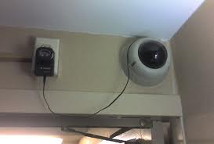
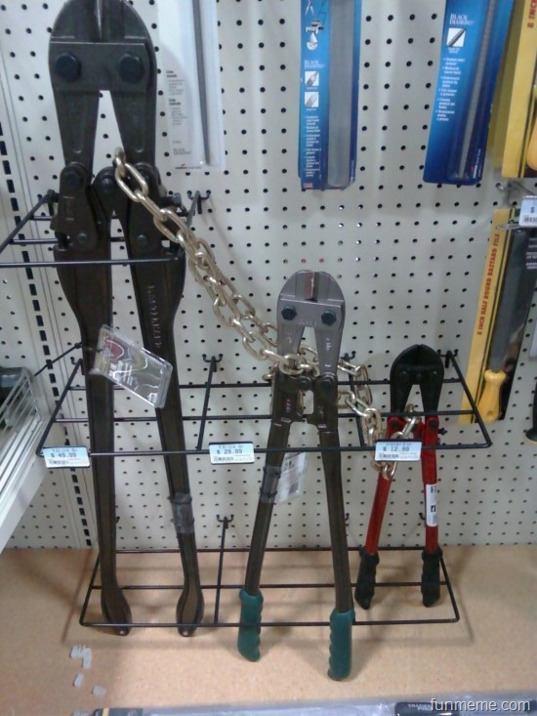
Failed Security

Slide 89
Threats to physical security
Natural hazards (floods, tornadoes, fires, temperatures)
Supply system threats (power outage, water, gas, WAN connection etc)
Manmade threats (unauthorized access, explosives, damage by disgruntled people, accidents, theft)
Politically motivated threats (strikes, riots, civil disobedience)

Slide 90
Physical security fundamentals
Life safety goals* should always be #1 priority
Like in technical security, defense should be layered which means that different physical controls should work together to accomplish the goal of security.
Physical security can address all of the CIA fundamental principals*.

Slide 91
Planning Process
Threats should be classified as internal or external.
Risk analysis should be taken on a physical aspect.
Assets should be identified,
threats should be identified (probabilities calculated)
countermeasures put in place that are COST EFFECTIVE and appropriate to the level of security needed.
Physical security will ultimately be a combination of people, processes, procedures and equipment to protect resources.
(more)

Slide 92
Planning Process
The planning and security program should include the following goals.
Deterrence – fences, guards, signs
Reducing/Avoiding damage by Delaying attackers – slow down the attackers (locks, guards, barriers)
Detection – motion sensors, smoke detectors, video analytics
Incident assessment – response of guards, and determination of damage level
Response procedures – fire suppression, law enforcement notification etc

Slide 93
Planning process
Idea is to avoid having a physical security violation in the first place!
If you cannot stop a violation then countermeasures should mitigate damage problems.
This can be best accomplished by layering.
If a crime happens you must be able to detect it, and response should be implemented.
Remember this is the same process that we cover in Risk Analysis! All the same processes and concepts apply.

Slide 94
Target Hardening ()
Focuses on denying access through physical and artificial barriers. (alarms, locks, fences). Target hardening can lead to restrictions on the use, enjoyment and aesthetics of an environment.

Slide 95
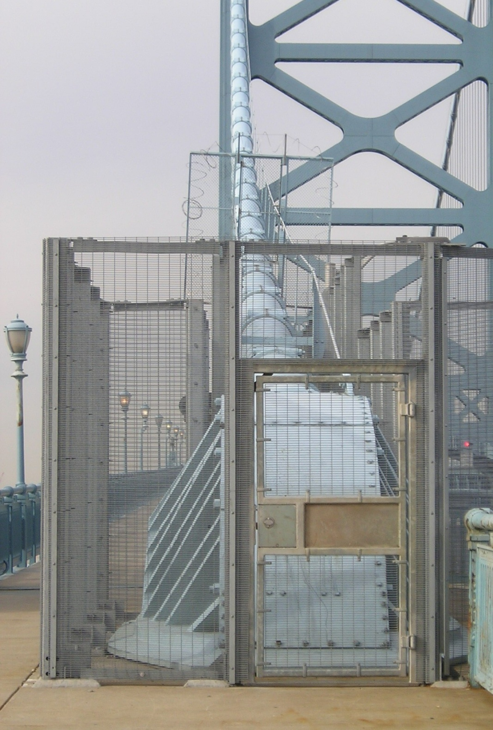
Target Hardening

Slide 96
CPTED
Crime Prevention Through Environmental Design – The idea is that proper design of a physical environment can reduce crime by directly affecting human behavior.*
CPTED provides guidance in loss and crime prevention through properly facility construction and environmental components and procedures.

Slide 97
CPTED guidelines
Examples
Hedges and planters should not be more than 2.5 feet tall.
Data center should be at the center of a facility.
Street furniture should encourage people to site and watch what is going around them.
Landscaping should not provide places to hide.
Put CCTV camera in plain view so criminals are aware they are being watched and recorded.
Be able to determined what type of physical countermeasure are influenced by CPTED

Slide 98
CPTED
CPTED provides three main strategies to bring together physical environment and social behavior to increase overall protection:
We will talk about these strategies on the upcoming slides.
Natural Access Control*
Natural Surveillance*
Territorial reinforcement*

Slide 99
CPTED (Natural Access Control)
Natural Access Control – tries to controls flow of people entering and leaving a space by the placement of doors, fences, lighting and landscaping.
Clear lines of sight and transparency are used to discouraged potential offenders.
Natural barriers can be used to create physical security zones
Methods are natural or organic, not target hardening

Slide 100
CPTED (Natural Surveillance)
Natural Surveillance attempts to discourage criminals by providing many ways for others to observe potential criminal behavior.
Examples:
Benches
Parks and other public areas
Vehicular high traffic areas

Slide 101
CPTED (Territorial Reinforcement)
Creating a space that emphasizes an organizations sphere of influence* so employees feel ownership of that space. The idea is that they will “protect” the environment (report suspicious activities, never directly intervene). It can also make criminals feel vulnerable or feel that they do not belong there.
Some examples are listed on the next page

Slide 102
CPTED (Territorial Reinforcement)
Decorated Walls
Fences
Landscaping
Lights
Flags
Company signs
Decorative sidewalks
Company “activities” (i.e.. Barbeques)

Slide 103
Good approach to Physical Security
A good approach is to design generically using CPTED first and then apply target hardening concepts where appropriate.

Slide 104
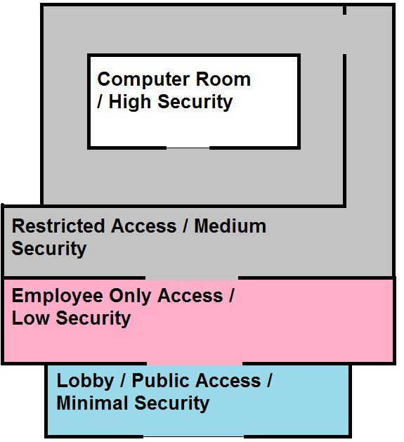
Security Zones
Zones are used to physically separate a location into different security areas.
Each inner level becomes more restricted and more secure
Stronger Access Control and Monitoring at the entry point to each zone

Slide 105
Designing a Physical Security Program
When designing a physical security program you must consider the following
HVAC systems
Construction materials
Power distribution systems
Communications lines
Hazardous materials
Proximity to airports, highways, roads
Proximity to emergency service
etc

Slide 106
Facilities
When building a new facility there are several considerations
Visibility
Surrounding area and external entities
Crime rate
Proximity to police, medical and fire stations
Accessibility
Roads/access
Traffic
Proximity to airports etc.
Natural disasters
Probability of floods, hurricanes
Hazardous terrain (mudslides, falling rocks (really?!?), excessive snow or rain)

Slide 107
Construction
A large number of variables need to be considered when building a facility depending on what the facility is trying to protect and. For example (if documents are stored, fire-resistant materials should be used)
(read the bullet points on 418/419) you should memorize these.

Slide 108
Entry Points
Entry points into a building or control zone must be secured.
including windows
Including ventilation ducts etc.
All components of a door should be equally as strong (hinges, door construction) as security is only as good as the weakest link

Slide 109
Doors
Fire codes dictate that exit bars be on doors.
Doors can be hollow core or solid core, hollow core doors should only be user internally*.
Doors with automatic locks can be
Fail safe* - what does this mean?
Fail secure* - what does this mean?

Slide 110
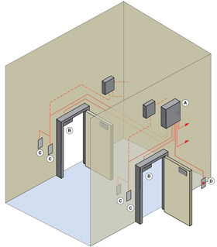
Man Trap*

Slide 111
Windows
There are different type of windows that you should now about*
Standard glass – residential home/easily broken
Tempered glass – glass that is heated and then suddenly cooled. 5-7x stronger than regular glass
Acrylic glass (plexiglass/lexan) – stronger than regular glass, but gives off toxic fumes if burnt.
(more)

Slide 112
Windows
Glass with embedded wires – avoids glass shattering
Laminated glass – two sheet of glass with a plastic film in between. Harder to break.
Glass can be treated with films to tint and increase strength for security.

Slide 113
Computer Room
Computer rooms are where important servers and network equipment is stored.
Equipment should be placed in locked racks*.
Computer rooms should be near the center of the building, and should be above ground, but not too high that it would be difficult to access by emergency crews*
Strict access control should be enabled*.
They should only have 1 access door, though they might have to have multiple fire doors*
(more)

Slide 114
Computer Room
Computer Room should have positive air pressure*
There should be an easy to access emergency off switch*
Portable fire extinguishers
Smoke/fire sensors should be under raised floors*.
Water sensors should be under raised floors and on ceilings*
(more)

Slide 115
Computer Room
Temperature and Humidity levels should be properly maintained*
Humidity too low, static electricity*
Humidity too high, corrosion of metal parts*
CR should be on separate electrical systems than the rest of the building
Should have redundant power systems and UPS

Slide 116
Protecting Assets
Organizations must protect from theft. Theft of laptops is a big deal especially if private information is on the laptop (Confidentiality,Legal).
You should understand best practices in regards to physically protecting things from being stolen.
Inventory all laptops including serial number
Use disk encryption on laptops
Do not check luggage when flying
Never leave a laptop unattended
Install tracking software on laptops (low jack type software)
Password protect the BIOS (See next slide)
(more)

Slide 117
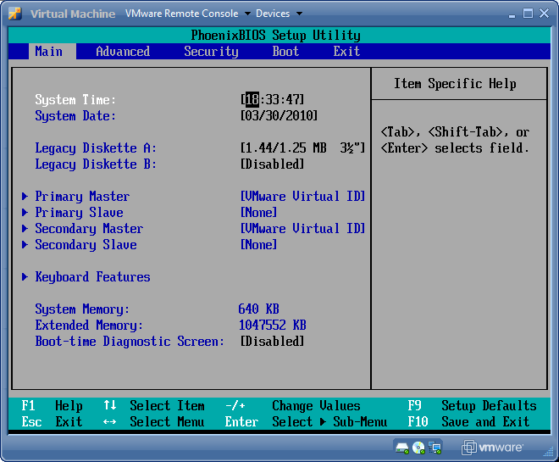
BIOS

Slide 118
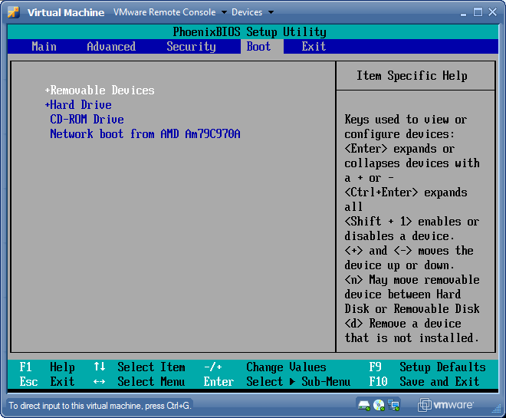
BIOS

Slide 119
Protecting Assets
You should also be aware of the types of safes that exist
Wall safe
Floor safe (always bolt to foundation)
Chest (stand alone)
Depositories (safes with slots)
Vaults (walk in safes)

Slide 120
Internal Support Systems
Power is critically important for data processing we will talk about some different power issues and concerns to be aware off.

Slide 121
Electrical Power Issues
Electromagnetic Interference – electromagnetic that can create noise. (motors can generate fields)
Radio Frequency Interference – fluorescent lights
(see next slide for visualization)

Slide 122
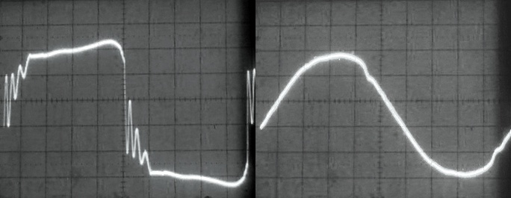
Electric power issues
Power interference that stops you from getting “clean power” this is called line noise.

Slide 123
Electrical Power Issues
There are times where the voltage delivered falls outside normal thresholds
Excess
Spike – momentary high voltage*
Surge – prolonged*
Shortage
Sag/dip – momentary low voltage*
Brownout – prolonged low voltage*
Loss
Fault – momentary outage*
Blackout – prolonged regional outage*

Slide 124
Electrical power issues
In rush current – when a bunch of things are turned on, power demands are usually higher, and may stress power supplies, causing a sag/dip or a trip breakers.
Try to have computer equipment on different electrical supplies than other office equipment
DO NOT install microwaves or vacuums on computer power circuits.

Slide 125
Power
UPS (need visualization)
Online
Standby
Power line conditioners
Backups generators
Know what each power countermeasure is used for or when they are appropriate.

Slide 126
Power best practices
Use surge protectors on desktops
Do not daisy change surge protectors (see next slide)
Employ power monitor to detect current and voltage changes
Use regulators or line conditioners in computer rooms
Use UPS systems in computer rooms
If possible shield power cables in conduit
Do not run power over or under fluorescent lights

Slide 127
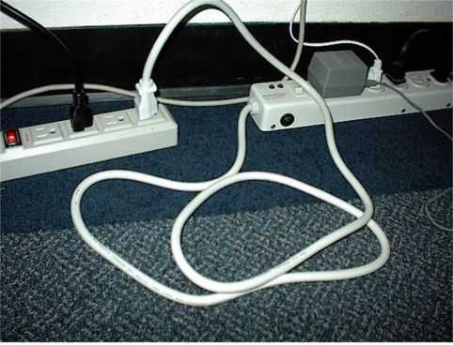
Daisy Chained Power Strips

Slide 128
Environmental Issues
Improper environments can cause damage to equipment or services
Water and Gas
Make sure there are shutoff valves and that they have positive drains (flow out instead of in, why?)
Humidity*
Humidity must not be too high or too low
Low – static
High – rust/corrosion
Hygrometer measures humidity
(more)

Slide 129
Environmental Issues
Static electricity – besides ensuring proper humidity
use anti-static flooring in data processing areas
Don’t use carpeting in data centers
Wear anti-static bands when working inside computers.

Slide 130
Environmental Issues
Temperature – Should not be too high or equipment failure will occur. Room temps should be in the 60s ideally.
Ventilation
should be closed loop (re-circulating)
Positive pressure
If a fire is detected HVAC should be immediately turned off.

Slide 131
Fire prevention
It’s obvious that you should have fire prevention, detection and suppression systems. Which types you use depends on the environment.
Fire detection systems –
Smoke activated (using a photoelectrical device)
Heat activated
Rate of rise sensors (temperature increase per min.)
Fixed temperature sensors

Slide 132
Fire prevention systems
Detectors need to be properly placed
On and above suspended ceilings*
Below raised floors*
Enclosures and air ducts*
Uniformly spread through normal areas*

Slide 133
Fire suppression ()
A fire needs fuel, oxygen and high temperatures to burn*. There are many different ways to stop combustion
fuel – soda acid (remove fuel)*
oxygen – carbon dioxide (removes oxygen)*
Temperature – water (reduces temperature)*
Chemical combustion – gas (interferes with the chemical reactions)*

Slide 134
Fire Suppression
Different fire suppression types based on class of fire
A
B
C
D
(we’ll talk about each of these)

Slide 135
Fire Suppression
A – Common Combustibles*
Use for: Wood, paper, laminates
Uses water or foam as suppression agent
B – Liquid*
Use for: gas or oil fires
Use: Gas (CO2), foam, dry powders

Slide 136
Fire Suppression
C – Electrical*
Use on: electrical equipment and wires
Uses: Gas, CO2, dry powder
D – Combustible metals
Use on: combustible metals (sodium, potassium)
Uses: dry powder

Slide 137
Fire Suppression (Gases)
Before any type of dangerous gas (CO2) is released there should be some type of warning emitted. (CO2 will suffocate people)
Halon is a type of gas that used to be commonly used, it is no longer used do to CFCs. It was banned by the “Montreal protocol”* in 1987*. effective replacement is FM-200 or others on top of pg 444*

Slide 138
Fire Suppression Note
HVAC system should be set to shutdown when an automatic suppression system activates.

Slide 139
Fire Suppression Systems
Now we need to understand automatic fire suppression systems

Slide 140
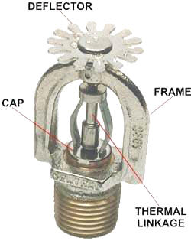
Sprinkler Heads
The thermal linkage is often a small glass tube with colored liquid that is designed to shatter at a fixed temperature.
The fire will heat the Thermal Linkage to its break point, at which point the water in the pipe will flow freely through the opening at a high pressure. The pressure of the water causes it to spread in a wide area when it hits the deflector

Slide 141
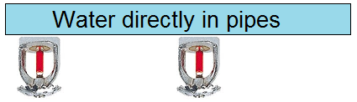
Automatic fire suppression
Sprinklers –
Wet Pipe – high pressure water in pipe directly above sprinkler heads
Deluge – Type of wet pipe with a high volume of water dispersal, not used for data centers.

Slide 142
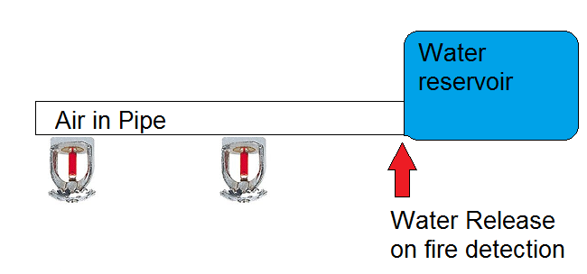
Automatic fire suppression
Dry Pipe – Air in pipe overhead, water in reservoir. Used where freezing temperatures may occur*.

Slide 143
Automatic fire suppression
Pre action – like dry pipe but water is released / primed by an independent sensor

Slide 144
Fire random tidbit
Plenum – The crawlspace above a ceiling or below the floor.
Know the term
Cables run in the Plenum areas MUST be plenum cable which gives off less toxic fumes when burning.

Slide 145
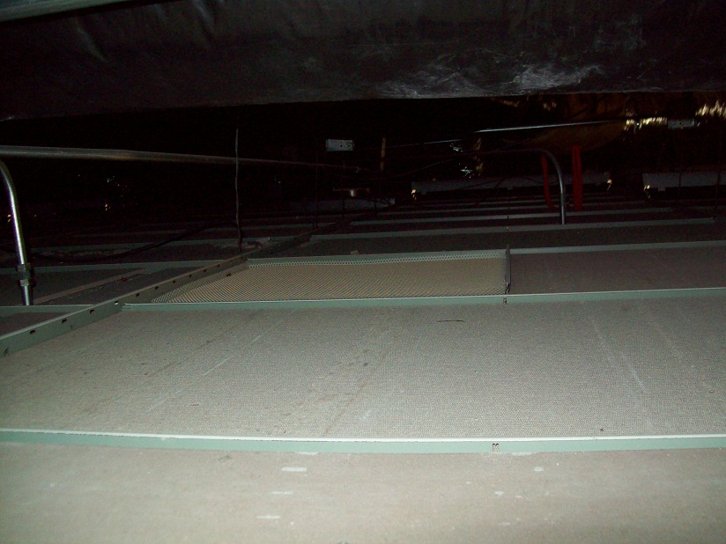
Plenum

Slide 146
Perimeter security
Perimeter security is concerned with protecting the outside of your facility. Ensuring that there is no un-authorized physical access. Perimeter security can implement multiple controls to keep the facility secure
Some controls that are used that we will look at are
Locks
Personnel access controls
Fencing
Lighting
Bollards
Surveillance devices
Intrusion detection systems
Guard dogs

Slide 147
Perimeter Security
Locks – purpose of locks is to DELAY* intruders, until they can be detected and apprehended. There are multiple types of locks that we will talk about
Mechanical
Combination locks
Cipher locks

Slide 148
Locks
Mechanical – use a physical key (Warded lock or tumbler)
Warded lock – old doors, basic padlock, cheap (image)
Tumbler lock – more pieces that a warded lock, key fits into a cylinder which moved the metal pieces such that the bolt can slide into the locked and unlocked position.
Pin tumbler – uses pins
Wafer – uses wafer (not very secure)

Slide 149
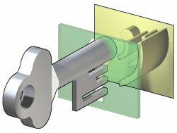
Warded Lock

Slide 150
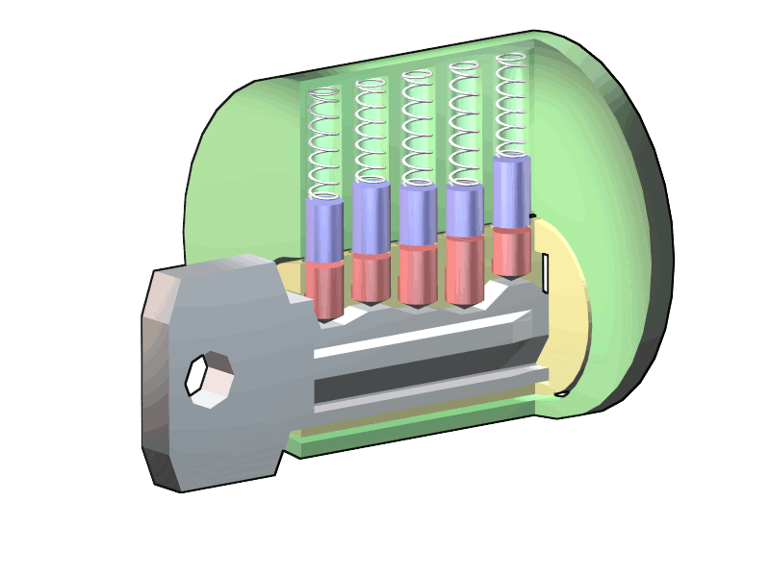
Standard Tumbler Lock

Slide 151
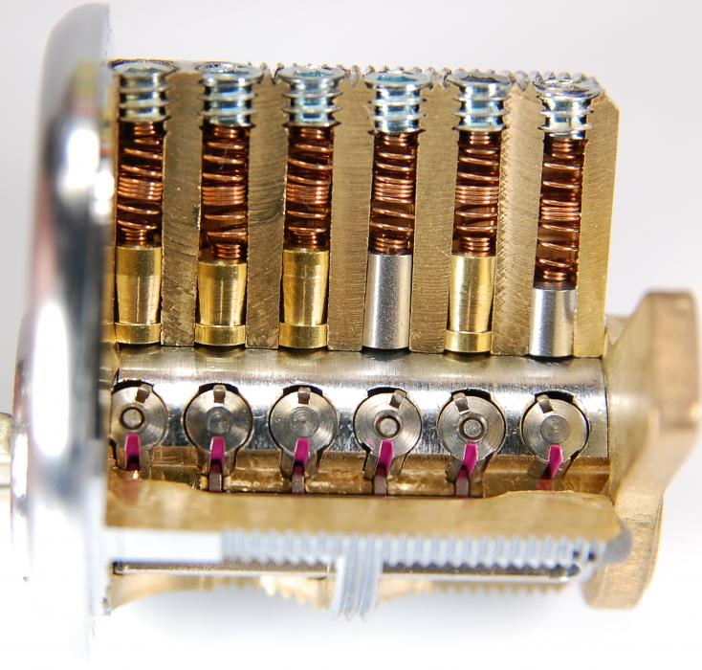
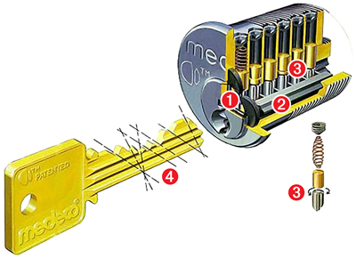
Medco High Security Tumbler

Slide 152
Locks types (453)
There are different lock grades*
Grade 1 – commercial
Grade 2 – heavy duty residential, light commercial
Grade 3 – residential throw away locks
There are also 3 cylinder categories
Low – no pick or drill resistance provided
Medium – a little pick resistance
High – higher degree of pick resistance

Slide 153
Attacks against key type locks
Tension wrench – shaped like an L and is used to apply tension to the cylinder, then use a pick to manipulate the individual pins*.
Pick – used in conjunction with a tension wrench to manipulate the pins into place so you can turn the cylinder*
Visualization next slide

Slide 154
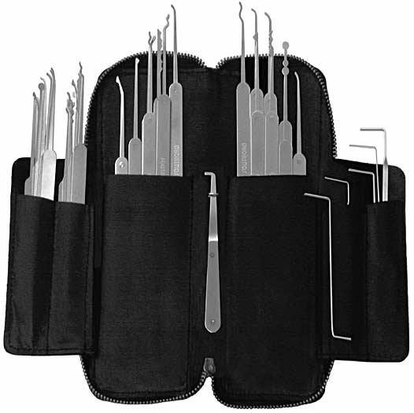
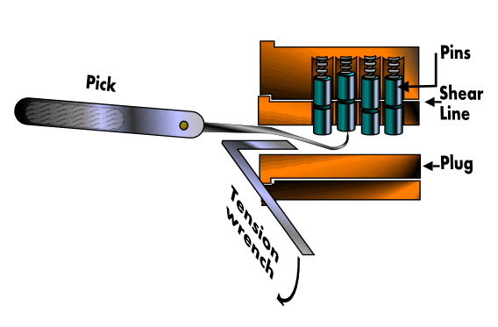
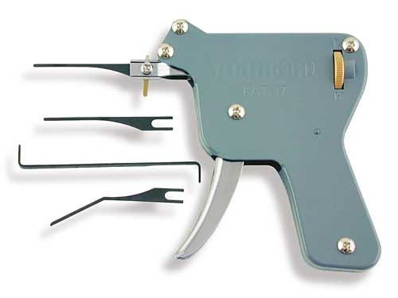
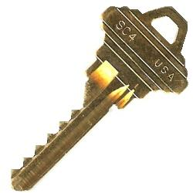
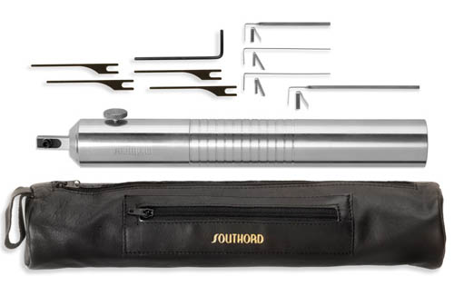
Lock Picking and Bumpkey

Slide 155
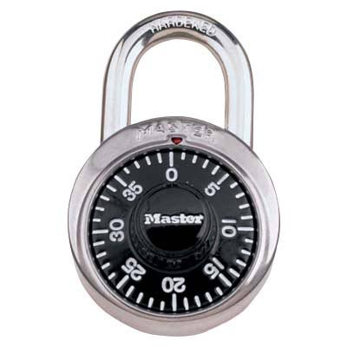
Locks
Combination locks – rather than use a key, turn

Slide 156
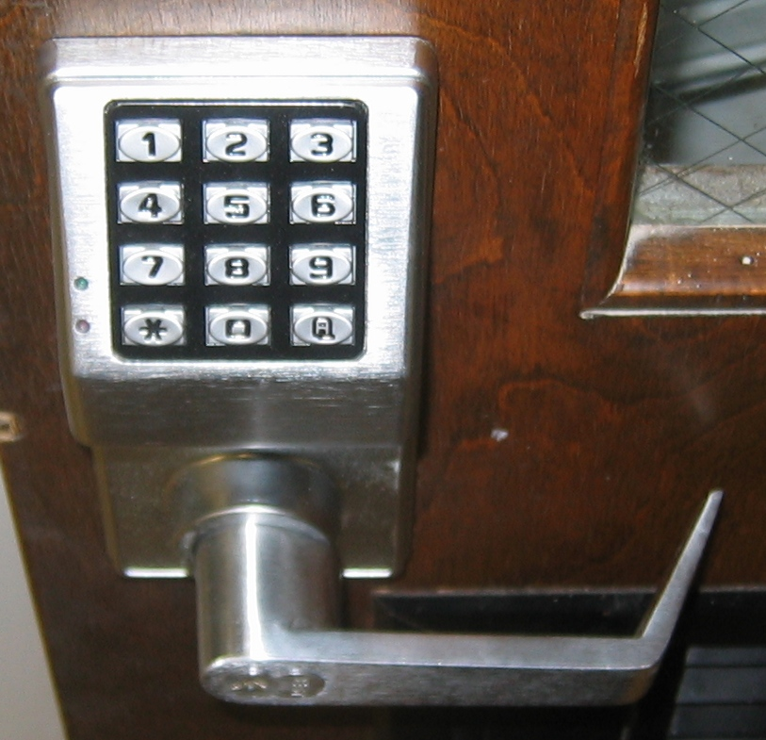
Cipher Lock*

Slide 157
Cipher Lock
Cipher locks – electronic locks*
Advantages*:
Combination can be changed
Combination can be different for based on role
Can work during different times of day
Can have override codes
Subtype of Override Code is an emergency code*
Disadvantages
Combinations can be viewed or verbally transferred
Numeric limitation can make guess work easier
Commonly used digits can be traced

Slide 158
Device Locks
Device Locks - Computer equipment sometimes must be locked (laptops, or physically blocking out slots). Some type of device locks are

Slide 159
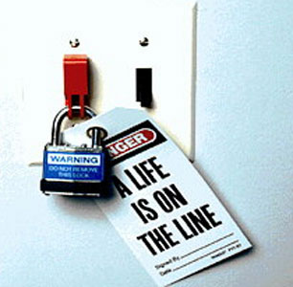
Switch Lock

Slide 160

Port / Laptop Lock
Slot locks physically lock into the expansion slots to physically secure systems.

Slide 161

Device Locks
Port controls – block access to floppy or USB ports
Cable traps – lock down cables from being unplugged and removed.

Slide 162
Personnel access controls
There are different technologies to grant access to a building.
User activated – a user does something (swipe cards, biometrics)
Proximity devices/transponders – a system recognizes the presence of an object. (Electronic access control tokens) is a generic term for proximity authentication systems)

Slide 163
Fencing
Can deter and delay intruders
Fences 3-4 feet high only deter casual trespassers*
Fences 6-7 feet high are considered too high to climb easily*
Fences 8 feet high should are considered serious.*
(more)

Slide 164
Fencing
Memorize the gauges and mesh size chart on pg 457
Fencing best practices
Fences should be a first line of defense.*
Critical areas should have fences of 8 feet*.

Slide 165

Bollards*

Slide 166
Bollards
Bollards are small concrete pillars, sometimes containing lights or flowers.
They are used to stop people from driving through a wall, often put between a building and parking lot.
They can be arranged to form a natural path for walking.*

Slide 167
Lighting
Lighting is obviously important in perimeter security. It decreases the probability of criminal activity*.
Each light should cover it’s own zone and there should not be gaps in the coverage.*
Coverage in fact should overlap.*
Lighting should be directed AWAY from the security guards etc.*

Slide 168
Surveillance
Surveillance systems are a detective control. Generally these are CCTV systems.
CCTV systems consist of
Cameras
Transmitters
Receivers
Recording systems

Slide 169
Surveillance
Most camera are charged coupled devices that takes light from a lens and turns it into an electrical signal.
There are two types of lenses in CCTV camera
Fixed focal length
Variable focus length (zoom lens)
We will define focal length next slide
(more)

Slide 170
Focal Length
Focal Length = The distance from the surface of a lens or mirror to its focal point.
short focal length = wide angle*
long focal length = narrow, but higher magnification*

Slide 171
Depth of Field
Depth of field = Depth of field is the range of distance within the subject that is acceptably sharp
large depth of field = everything is generally sharp
short depth of field = something is specifically "focused" on where everything else is fuzzy.
(see next slide)

Slide 172

Depth of Field

Slide 173
Depth of Field
depth of field increases as the lens opening DECREASES*
depth of field increases as the focal length DECREASES*
Best combination to cover a large area is a wide angle lens with a small lens opening*
(short focal length and large depth of field)

Slide 174
Surveillance
Focal Length - If you don’t have a CCTV camera that can change, you must pick an appropriate focal length for your application.
Generally you should have cameras with auto-irises that can adjust to how bright the outside conditions are
Zoom lenses allow you to change
PTZ cameras (pan, tilt, zoon)

Slide 175
Intrusion Detection Systems
IDS (physical IDS, NOT network IDS) – help detect the physical presence of an intruder.
Can be multiple types.

Slide 176

Electromechanical IDS
Electromechanical – traditional types, determine a opening of a window by a break in connectivity.
Vibration sensors are also electromechanical
Pressure pads are also electromechanical

Slide 177

Photoelectric IDS
Photoelectric – uses light beams to detect when something crosses the beam.
Brian E. Brzezicki

Slide 178
IDS
Acoustical Detection – uses sound (like sonar)
Proximity detector/capacitance detectors – emits a measurable magnetic field. If field is disrupted it sets off the alarm. (usually this field is a very small area, as magnetic fields disperse quickly as the area increases)

Slide 179

Passive Infrared IDS
Passive Infrared (PIR) – monitors heat signatures in a room. (a lot of home automatic light systems are of this type)

Slide 180

Patrols and Guards
Guards – provide a dynamic response, guards can make decisions based on the situation, which most other IDS cannot.*
Dogs – highly useful in detecting intruders and discouraging attacks.*

